Slide 1
M3-MIFARE DESFire Training
MIFARE DESFire EV1 Command Exercise
Abu Ismail, BUID CAS
MIFARE DESFire EV1
Standard Product Training
2013

Slide 2
Content
Introduction to MIFAREdiscover
Understanding different states of MIFARE DESFire EV1
Practicing MIFARE DESFire EV1 commands
M307_MIFARE_DESFire Training - MIFARE DESFire EV1 Commands Exercise_AIv13.01.ppt

Slide 3
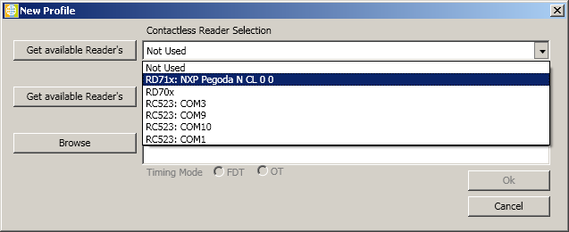
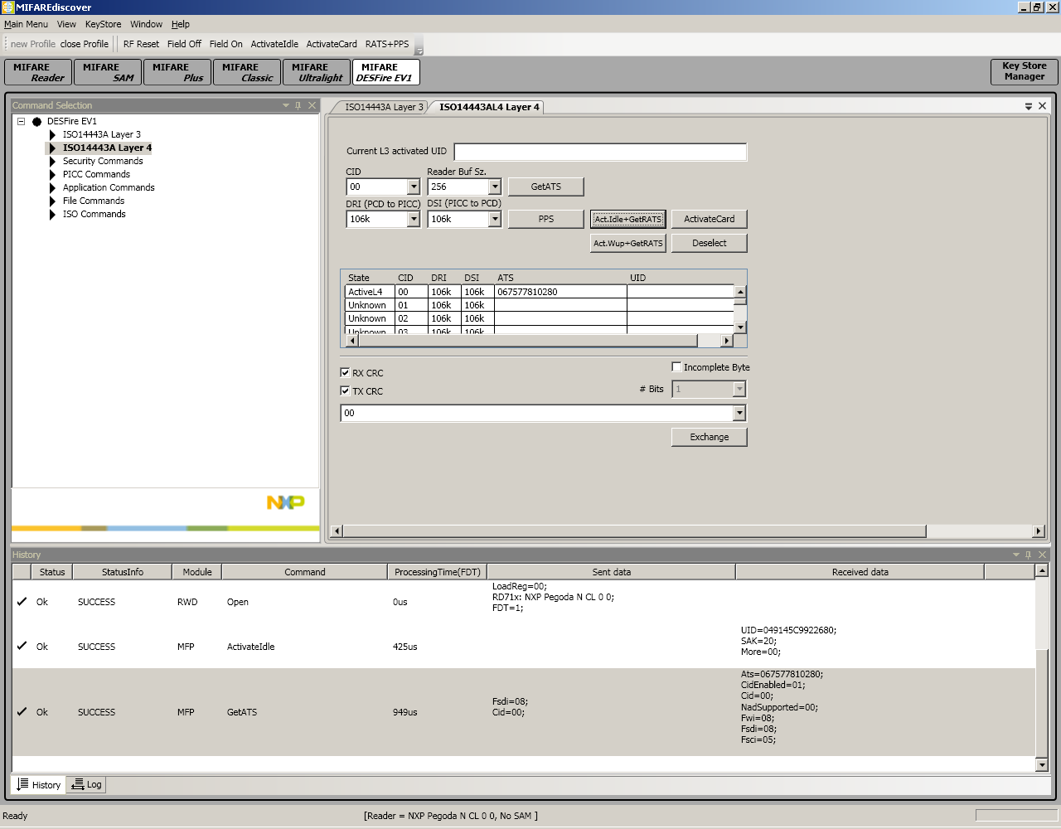
MIFAREdiscover Introduction
Step 1: Run MIFAREdiscover
Step 2: Select contactless reader “RD71x: NXP Pegoda N CL 0 0”.
Follow your trainer introduction session
Please note, this tool is an alpha version and not tested thoroughly.
M307_MIFARE_DESFire Training - MIFARE DESFire EV1 Commands Exercise_AIv13.01.ppt

Slide 4
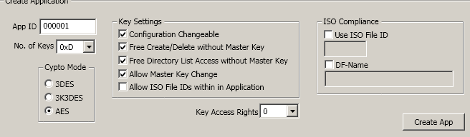
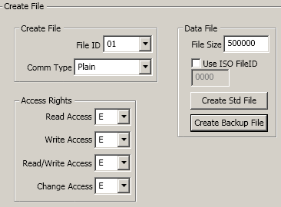
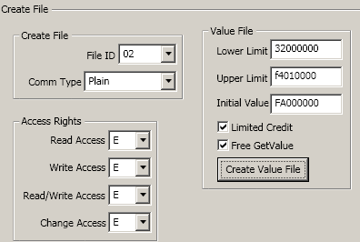
Workshop 1a: MIFARE DESFire EV1 commands
Format MIFARE DESFire EV1 card
Create an application with App ID=000001
  No. of keys = 0xD
  Key setting: check all boxes (ISO file ID optional)
  Key Access rights:0
  Crypto Mode: 3DES
Create an application with App ID= 000002 (same conditions)
Crypto Mode: AES
Create an application with App ID= 000003 (same conditions)
Crypto Mode: 3KTDES
Get Application IDs
Select App ID 000002
Create Back up Data File with File ID 01
  Plain communication, use key ‘E’ for all access rights
  File size: 80 bytes (500000)
Create Value File with File ID 02
  Plain communication, use key E for all access rights
  Upper Limit: 500(F4010000); Lower Limit: 50 (32000000); Initial Value: 250(FA000000); with limited Credit
2
7
8
M307_MIFARE_DESFire Training - MIFARE DESFire EV1 Commands Exercise_AIv13.01.ppt

Slide 5
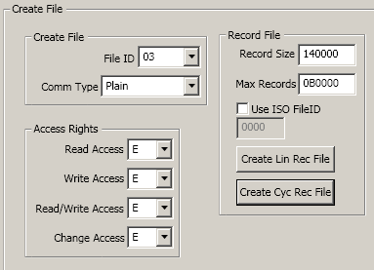
Workshop 1b: MIFARE DESFire EV1 commands
Create Record File with File ID 0x03
  Plain communication, use key ‘E’ for all access rights
  Record size: 20 bytes(140000); Number of records: 11(0B0000); make it cyclic
Check File IDs , Issue “Get File Ids” command.
Check File Settings of file 02
Write “00112233445566778899” to data file 01, length = 0A0000, Offset 000000; Commit Transaction; Read Data
Write “AABBCCDDEEFF” to data file 0x01, length = 060000
  Offset 050000; Commit Transaction
  Offset 000000; Length: 140000; Read Data
Write 111111111111 to Record File 03, length 060000, offset 000000.
  Read all records (No of records = 000000 = all records)
  Write 0x222222222222
  Write 0x333333333333
  Read all records (No of records = 000000 = all records)
1
M307_MIFARE_DESFire Training - MIFARE DESFire EV1 Commands Exercise_AIv13.01.ppt

Slide 6

Workshop 2a: MIFARE DESFire EV1 commands
“Homework”
Create an Application with AID=ABCDEF
  Application should have 6 keys
  Creation/deleting of file require application Master Key
  Authenticate with key #1 is needed for changing any key
Create a Data File with FID= E
  Communication of file is Full DES/3DES enciphering
  Set access condition as: Read & Write & Read/Write (Key #2), Change AC (Key #1)
  File size is 64 bytes
Create a Cyclic Record File with FID= 2
  Communication of file is DES/3DES MACing
  Set access condition as: Read (Key #3) & Write & Read/Write (Key #4), Change AC (Key #1)
  Record size is 16 bytes
  Number of record is 3
M307_MIFARE_DESFire Training - MIFARE DESFire EV1 Commands Exercise_AIv13.01.ppt

Slide 7
Workshop 2b: MIFARE DESFire EV1 commands
“Homework”
Requirement
Create a Value File with FID=4
  Communication of file is Full DES/3DES
  Set access condition as: Read (Key #3) & Write (Key #4), & Read/Write (Key #5), Change AC (Key #1)
  Set Upper Limit to 1000 and set Lower limit to 10
  Set Initial value to 100
  Enable Limited Credit function
Change the Application Keys as follow
  Key #1: 0x000102030405060708090A0B0C0D0E0F
  Key #2: 0xFFFFFFFFFFFFFFFFFFFFFFFFFFFFFFFF
  Key #3: 0xFFFFFFFFFFFFFFFF0000000000000000
Write any data into the Data files and Read it from the file to verify
Write 3 records with 16 bytes of data
Increase the Value File with 100 and then decrease it with 50
M307_MIFARE_DESFire Training - MIFARE DESFire EV1 Commands Exercise_AIv13.01.ppt

Slide 8
Thank you very much.
We appreciate your feedback.
Abu Ismail
Senior Engineer, Customer Application Support
Business Unit Identification
NXP Semiconductors Germany GmbH
Stresemannallee 101, 22529 Hamburg, Germany
Tel: +49(0)40 5613 5070, Mob:+49(0)15115210535, Fax:+49(0)40561365070
abu.ismail@nxp.com, http://www.nxp.com, http://www.mifare.net
M307_MIFARE_DESFire Training - MIFARE DESFire EV1 Commands Exercise_AIv13.01.ppt

